Slide 1
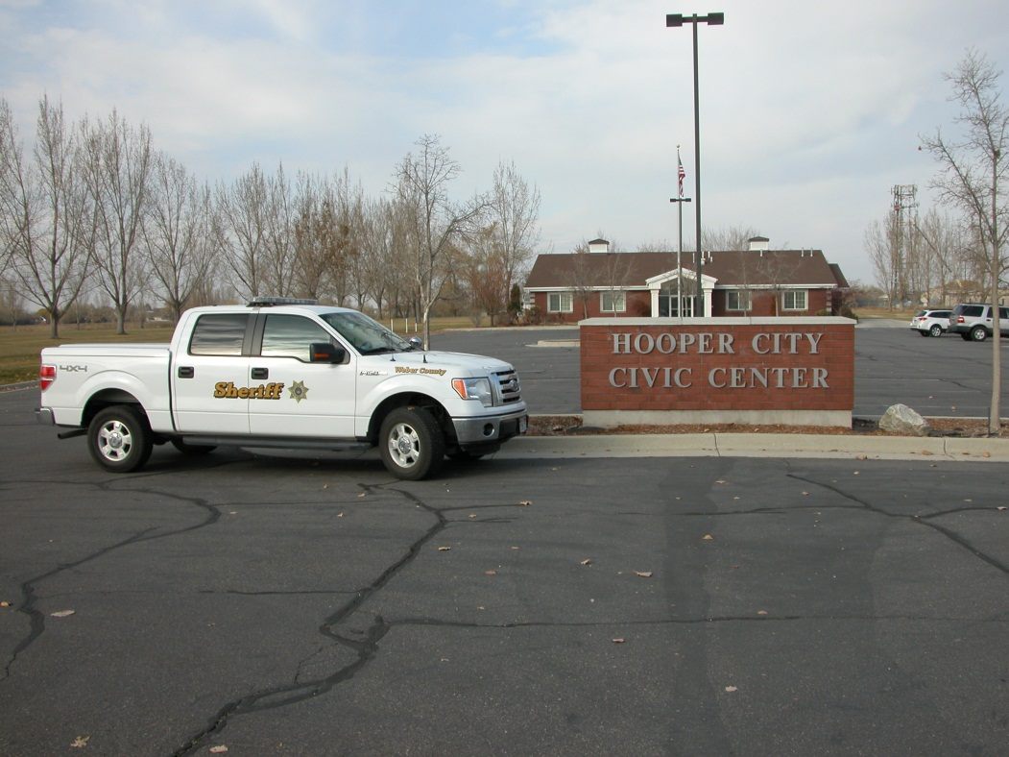
WEBER COUNTY SHERIFF’S OFFICE HOOPER CITY
2013 PROGRESS REPORT

Slide 2
CALLS FOR SERVICE 5-YEAR COMPARISON
TOTAL CALLS
2013 2395
2012 2066
2011 1974
2010 1871
2009 1782

Slide 3
CALLS FOR SERVICE 5-YEAR COMPARISON
REPORTS
2013 111
2012 86
2011 98
2010 83
2009 63

Slide 4
CALL BREAKDOWN
 |  | REPORTS
CALL DESCRIPTION | TOTAL |  | CALL DESCRIPTION | TOTAL
911 calls | 1 |  | Missing persons | 2
Alarms | 1 |  | Premise checks | 0
Animal problems | 28 |  | Prowler | 1
Assaults | 0 |  | Reckless drivers | 1
Assist fire department | 1 |  | Sex offenses | 0
Assist other jurisdictions | 1 |  | Stolen vehicles | 0
Burglaries | 4 |  | Stolen vehicles recovered | 1
Citizen assists | 5 |  | Suspicious activity | 5
Child abuse/neglect | 0 |  | Telephone harassment | 4
Civil disputes | 5 |  | Thefts | 3
Community policing | 21 |  | Threatened suicides | 1
Criminal mischief | 0 |  | Threats | 1
Custody disputes | 2 |  | Traffic accidents injury | 1
Deaths | 1 |  | Traffic accidents property | 0
Domestic violence | 1 |  | Traffic hazards | 1
Drug violations | 0 |  | Traffic stops | 14
Frauds | 2 |  | Vehicle burglaries | 2
Hit & run | 1 |  | VIN inspections | 1
Juvenile problems | 3 |  | Warrants | 3
Keep the peace | 2 |  | Welfare checks | 2
Medicals | 3
OCTOBER
217 cAlls
Priority 1 – 43
Priority 2 – 31
Priority 3 – 53
Priority 4 – 85
Priority 5 – 0
Priority 6 - 5

Slide 5
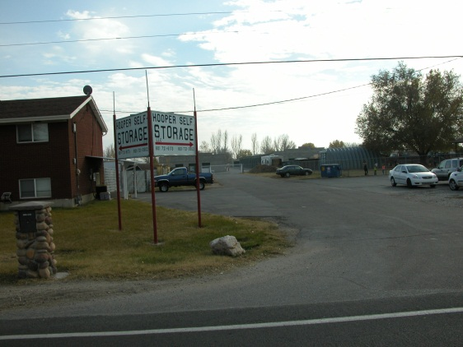
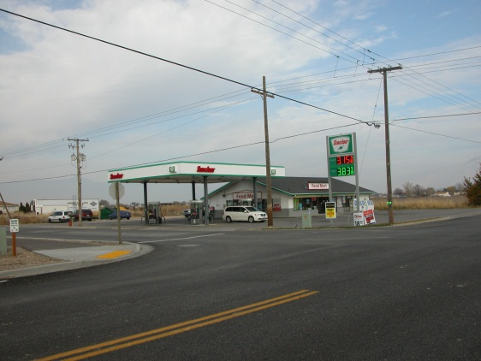
PROPERTY CRIMES
10/01 – Theft of tools. 4500 W. 5100 S. Possible civil dispute between roommates.
10/07 – Residential Burglary. 5200 S. 4700 W. Gaming system, other items taken. History of drug use at home.
10/08 – Vehicle burglary. 5000 S. 4700 W. Pills taken from unlocked truck.
10/08 – Theft. Left phone at park. Finder wouldn’t return it.
10/16 – Vehicle burglary. Widdison Auto. 5215 S. 5500 W. Trailer broken into.
10/23 – Burglary. Hooper Self-Storage. 5215 W. 4000 S. Storage unit broken into.
10/24 – Theft. Sinclair. 5500 S. 5500 W. Gas skip.
10/25 – Residential Burglary. 5200 S. 4700 W. Suspects break into home. Pepper spray occupant. History of drug use.
10/27 – Burglary. Hooper Self-Storage. 5215 W. 4000 S. Storage unit broken into.

Slide 6
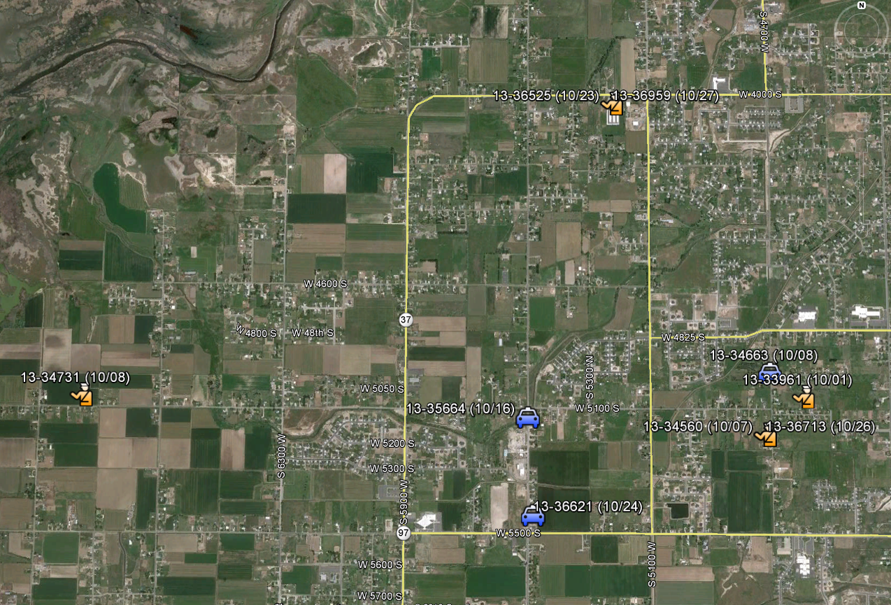

Slide 7
INVESTIGATIONS
A small percentage of offenders are responsible for a large percentage of crime
Many property crimes are drug-related
Identify criminal groups and individuals
Utilize all available resources
Solve crimes and make arrests
Significant drop in property crimes this summer due to arrests of targeted groups

Slide 8
CRIME PATTERNS AND CONCERNS
Overall call volume has increased in 2013. This is not due to an increase in crime but rather an increase in community-oriented policing efforts such as school visits.
Overall, violent crime and property crime rates remain relatively low.
Existing property crimes appear to be random and not isolated to a particular area.
More effective deployment of resources has allowed deputies to send more time in their assigned cities.

Slide 9
MAJOR CALLS = MAJOR RESPONSE
On 04/03/2013 A Six Year-old Boy went missing. The following resources were Deployed:
1 Lieutenant 2 sergeants 6 dEputies
5 Detectives 1 Risk Management AssisTant

Slide 10
CITATIONS 5-YEAR COMPARISON

Slide 11
Arrests 5-year Comparison
ARRESTS
2013 38
2012 21
2011 24
2010 28
2009 35

Slide 12
100+ ARRESTS in 2013
DEPUTY MARK WIAN

Slide 13
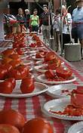
TOMATO DAYS
RODEO & Fireworks
(Saturday, August 31st)
Deputy Ortgiesen
Deputy Mcdonald
Deputy Jeffries
Parade & Finals Rodeo
(Monday, September 2nd)
Corporal Greenhalgh
Deputy Vandenberg
Deputy McDonald
Deputy Irvin

Slide 14
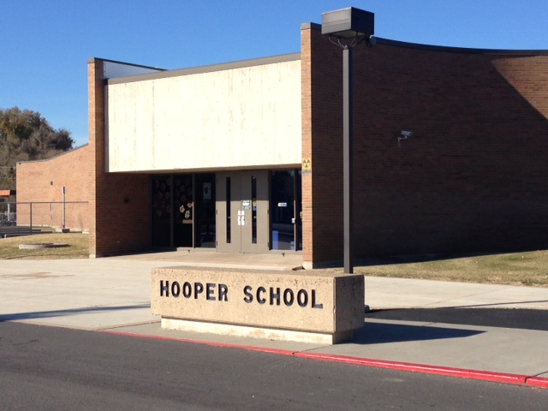
SCHOOL VISITS
HOOPER
ELEMENTARY
2013 71
2012 46
2011 42
2010 25
2009 15

Slide 15
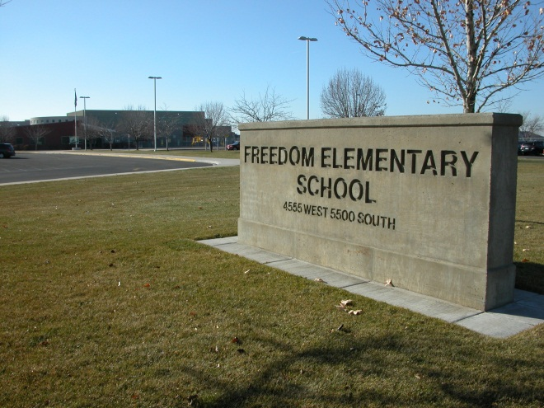
SCHOOL VISITS
Freedom
ELEMENTARY
2013 78
2012 28
2011 30
2010 20
2009 14

Slide 16
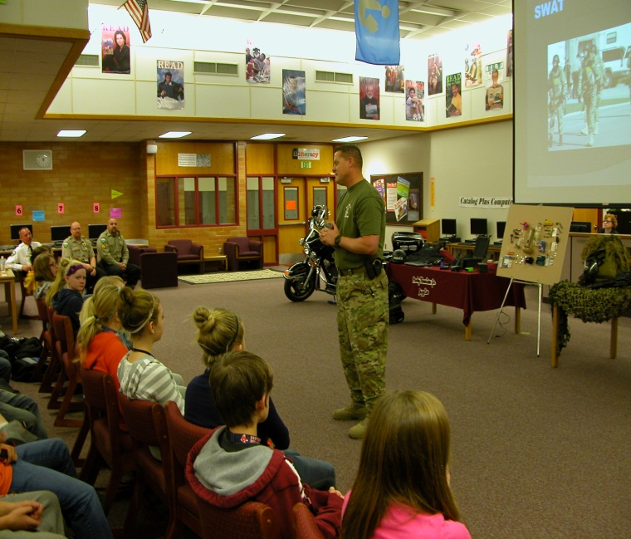
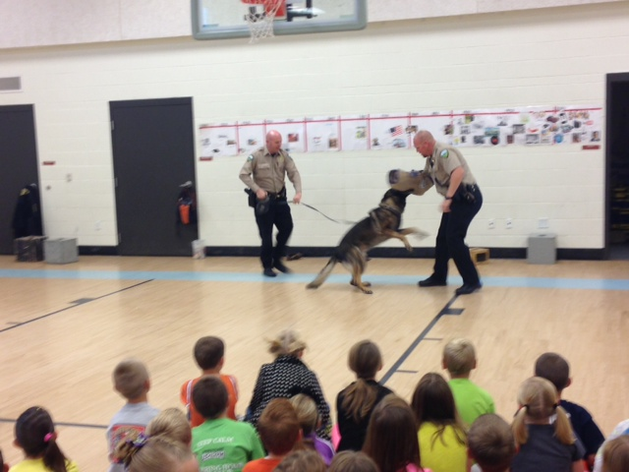
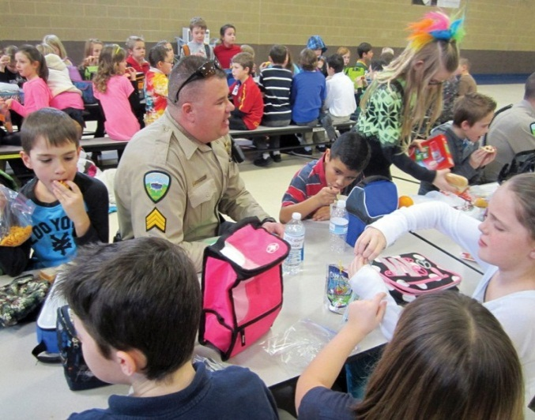
WORKING TOGETHER…

Slide 17
we can reach new heights!

Slide 18
QUESTIONS?
Follow us online @
www.co.weber.ut.us

